Slide 1

Jev Decision Benchmark
AIE × MLH HACKATHON · NOV 2026
Can a small decision model make AI agents cheaper, faster, or more accurate?
[Team names] · [repo / live site URL]
Notes:
One-sentence pitch: AI agents are being handed bigger and bigger toolboxes. We tested whether a small, fast decision model that picks the right few tools before the agent starts working makes the agent cheaper, faster, or more accurate. On real industry benchmarks it cut cost by a third to a half with no slowdown, and in one case it raised accuracy. Open with the problem on the next slide, not the model lineup.

Slide 2

Agents are drowning in tools
01 · THE PROBLEM
Agents connect to more and more tools through MCP, APIs and plugins. Every tool's description is sent to the LLM on every turn.
THE COST OF A BIG TOOLBOX
TODAY
100 tools
The whole phone directory
Every tool, every turn.
means tens of thousands of tokens before the agent does anything.
WITH A DECISION MODEL
A receptionist
More cost
More time
More wrong picks
"You want one of these three departments."
Notes:
Tool sprawl. Agents connect to more and more tools through MCP, APIs and plugins, and every tool's description is sent to the LLM on every turn. 100 tools means tens of thousands of tokens before the agent does anything. That costs money and time, and gives the model more ways to pick the wrong tool. Analogy, said once: handing someone the whole phone directory versus a receptionist who says 'you want one of these three departments.' From here on, call that receptionist the decision model.

Slide 3
Put a decision model up front
02 · THE IDEA
Request
→
Decision model scores every tool
→
Keeps the top 3–8
→
Agent sees only those
+ a "request more tools" escape hatch
ROLE
TESTED
CONTROL
It only narrows
Three decision models
LLM alone
The decision model does not do the task. The big LLM still does all the reasoning.
Jev, SubQ Snap and Gemini Decision.
The same LLM with no decision model in front of it.
Notes:
The pipeline: request, the decision model scores every tool, keep the top few (3 to 8), and the agent sees only those, plus a 'request more tools' escape hatch. Stress that the decision model does not do the task. It only narrows the choices; the big LLM still does all the reasoning. Three decision models were tested: Jev, SubQ Snap and Gemini Decision. The control is the same LLM with no decision model.

Slide 4
A fair, paired comparison
03 · THE TEST
HELD CONSTANT
GRADING
Only the shortlist changes
Graded by the benchmarks
Same LLM, prompt, tools, user simulator and judges in every setup.
Each benchmark's own grader scores the task, not ours: Sierra τ-bench (customer service) and MCPToolBench++ (finance, maps, search, files, payments).
PAIRING
TOOLBOX SIZE
Paired by task
Two toolbox sizes
Same task, same model, same tool list, with and without a decision model. A setup can't look fast by failing early.
Each task's normal tools, and a "sprawl" version padded to 87–100 tools.
Notes:
This slide heads off 'you rigged it.' Everything is the same except the shortlist. Tasks are graded by each benchmark's own grader. They come from Sierra's tau-bench (customer service) and MCPToolBench++ (finance, maps, search, files, payments). Comparisons are paired, so a setup cannot look fast by failing early. Two toolbox sizes: normal, and a sprawl version padded to 87 to 100 tools.

Slide 5
One task, 33 tools or 3
04 · AN EXAMPLE
"Where is IP 203.0.113.5 located?"
WITHOUT A DECISION MODEL
WITH SUBQ SNAP
33
3
tools in the agent's prompt
tools in the agent's prompt
maps_ip_location
map_ip_location
maps_geocode
Every map and finance tool, every turn.
0.56 s decision · 94% confidence in the right one
Notes:
Make it tangible before showing aggregates. Task: 'Where is IP 203.0.113.5 located?' Without a decision model the agent sees all 33 map and finance tools. With SubQ, the decision model took 0.56 seconds and kept 3 tools (maps_ip_location, map_ip_location, maps_geocode), with 94% confidence on the right one. The agent then works from a list of 3 instead of 33.

Slide 6
Cheaper every time, and no slower
05 · RESULTS
MAIN RUN · 286 GRADED EPISODES
TASK SUCCESS (%)
COST PER TASK ($)
Cheaper, every time
No slowdown
Right tool kept
Input tokens fall 25–57%, and cost follows.
The 0.16–0.7 s decision step is repaid by shorter prompts.
The correct tool was in the shortlist about 96% of the time.
Notes:
Main run, 286 graded episodes. Lead with cost, the most robust number, then accuracy, then 'and it's not slower.' Task success: LLM alone 62%, Jev 67%, SubQ Snap 69%, Gemini Decision 81%. Cost per task: $0.105 alone, then $0.072 (-32%), $0.070 (-33%), $0.059 (-44%). Input tokens fall 25 to 57%. The extra decision step (0.16 to 0.7 s) is repaid by the shorter prompts, and there is no statistically clear latency difference either way. The correct tool was in the shortlist about 96% of the time.

Slide 7
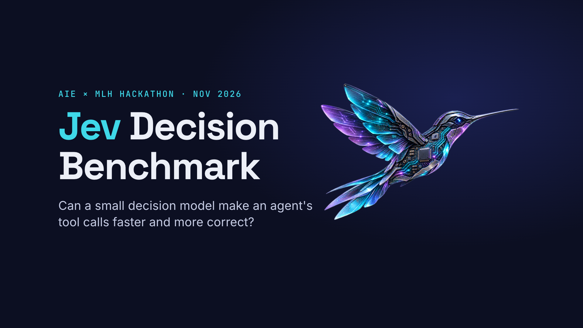
Live proof on the dashboard
06 · LIVE DEMO
LIVE DASHBOARD · SMOKE RUN, 20 ATTEMPTS
Setup | Carbon |  | Hydrogen
 | correct | time | correct | time
LLM alone | 69% | 22.5 s | 76% | 7.5 s
+ Jev | 57% | 15.0 s | 69% | 3.4 s
+ SubQ Snap | 44% | 26.1 s | 54% | 2.7 s
+ Gemini Decision | 62% | 31.7 s | 78% | 1.6 s
GEMINI HYDROGEN + GEMINI DECISION
78% correct; total time 7.5 s to 1.6 s
Does a decision model make an AI agent faster and more accurate?
GEMINI CARBON + JEV
Smaller smoke run · current data, subject to change
Total 22.5 s to 15.0 s, 12 pts less accurate
Notes:
Show the live dashboard only after the results, as proof it is real and repeatable. This table is the smaller smoke run: 20 attempts per setup, medians, correct percentage and total task time for Gemini Carbon and Gemini Hydrogen. It shows less of the accuracy gain than the main run, which we say on the next slide. Data is current and subject to change. To change the video: Insert > Video > Online Video and paste the YouTube link.

Slide 8
What we can't claim yet
07 · HONEST LIMITS
SAMPLE SIZE
ACCURACY
Hackathon-scale sample
The accuracy gain is not proven
Hundreds of episodes, not thousands, and single runs.
It is clearest for Gemini Decision, and the smaller smoke run showed less of it. Promising, not proven.
ESCAPE HATCH
COVERAGE
Heavy escape-hatch use in τ-bench
Not everything ran today
The agent used it in 56–81% of episodes: a long conversation needs tools beyond the first shortlist. The design handles it.
MedAgentBench (healthcare) is built and wired up but was not run, and Google's API spend-rate limit cut both runs short.
Notes:
Honest limits build credibility; judges respect it. Hackathon-scale sample: hundreds of episodes and single runs. The accuracy gain is clearest for Gemini Decision and the smaller smoke run showed less of it, so present it as promising, not proven. In long tau-bench conversations the agent often used the escape hatch (56 to 81% of episodes) because a multi-step conversation needs tools beyond the first shortlist. MedAgentBench (healthcare) is built and wired up but was not run today, and Google's API spend-rate limit cut both runs short.

Slide 9
Routing pays for itself
08 · SO WHAT?
NEXT STEPS
As toolboxes grow, sending every tool to the LLM on every turn does not scale.
01
More runs for tighter numbers
02
Run the healthcare benchmark (MedAgentBench)
A cheap routing step pays for itself: cheaper, no slower, and sometimes more accurate.
03
Find where the benefit grows with toolbox size
Notes:
So what? As toolboxes grow, sending every tool to the LLM every turn does not scale, and a cheap routing step pays for itself. Next steps: more runs for tighter numbers, the healthcare benchmark, and finding where the benefit grows with toolbox size.

